Slide 1

Counting refugees tents from satellite images
Ssip 2016 team D
Dominik Hirling
Marta Kiełbowicz
Emanuela Mihut
Asura Enkhbayar

Slide 2
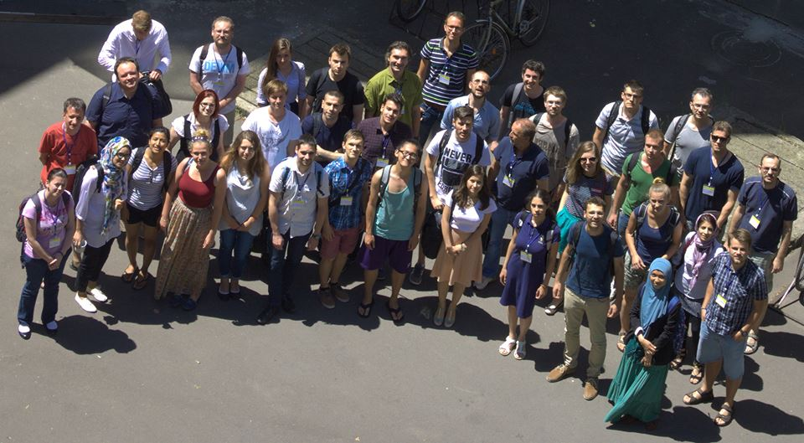



Who we are?

Slide 3
1
2
Teaching each other!
Tutorial time
Counting refugee tents on satellite imagery

Slide 4
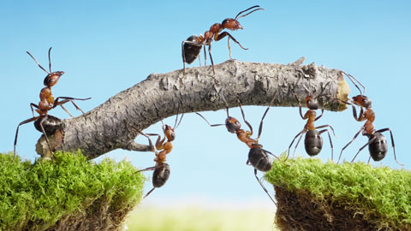


2. Teaching each other
4 different nations, 4 different scientific backgrounds & levels of experience in programming
Python
MATLAB
Image Processing tutorial

Slide 5
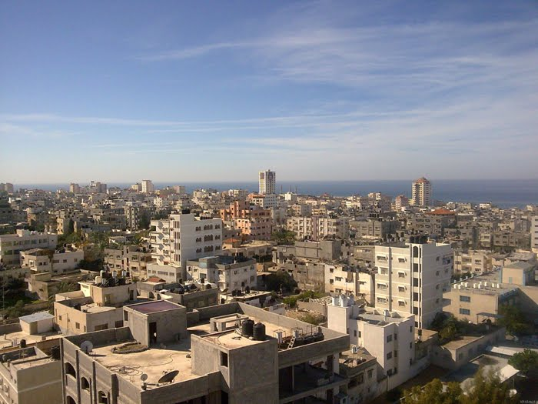
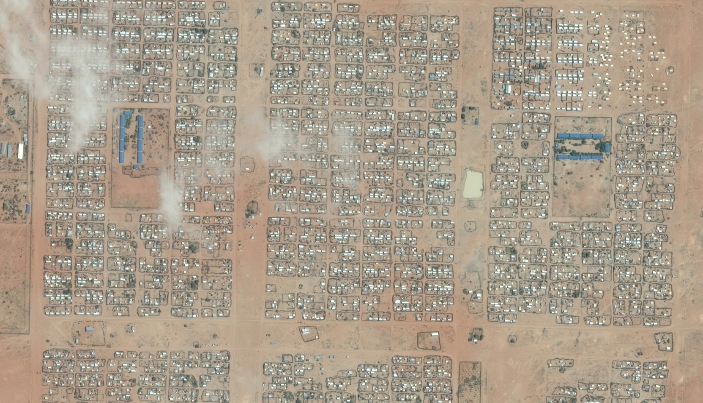
1. Initial project → Counting objects → Counting roofs
Oblique Aerial Imagery
Satellite (nadir) Aerial Imagery

Slide 6
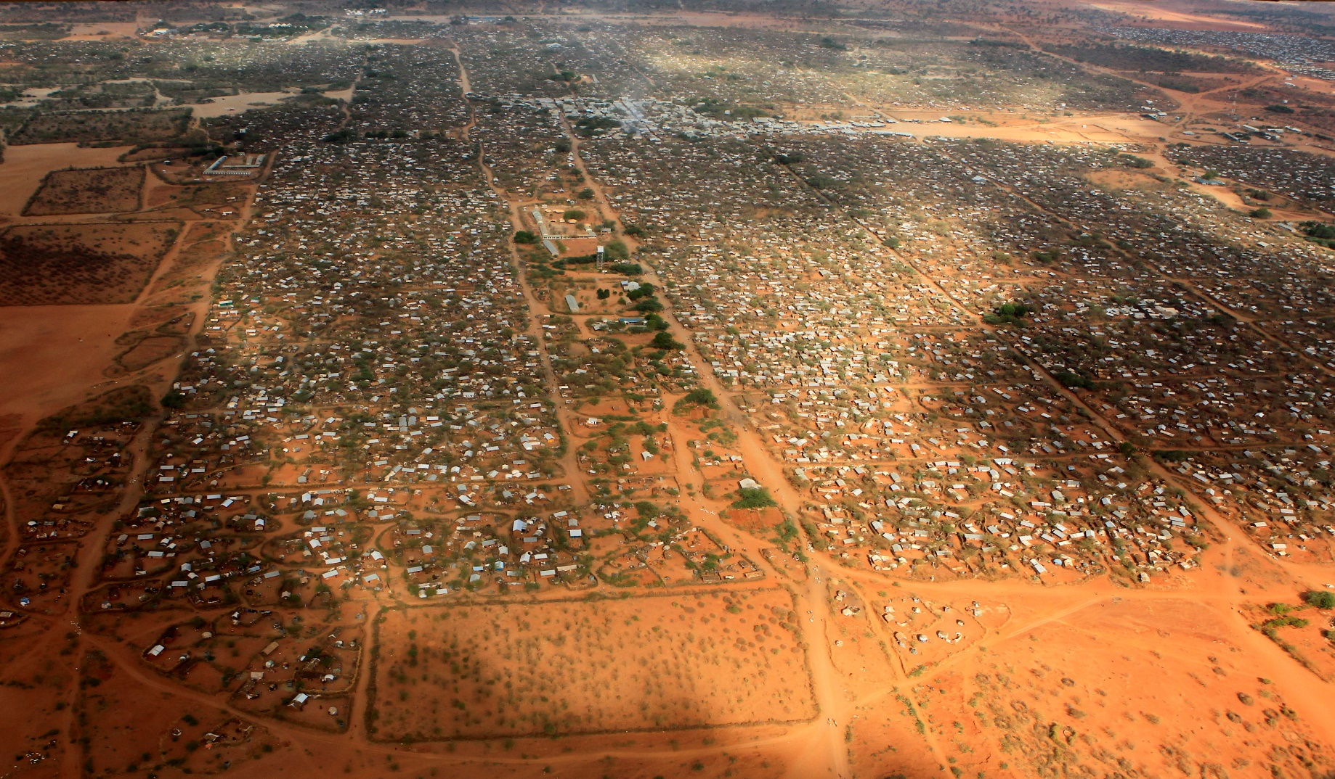
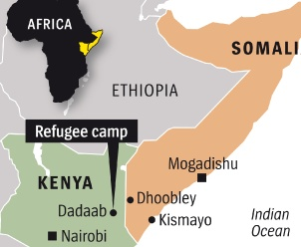
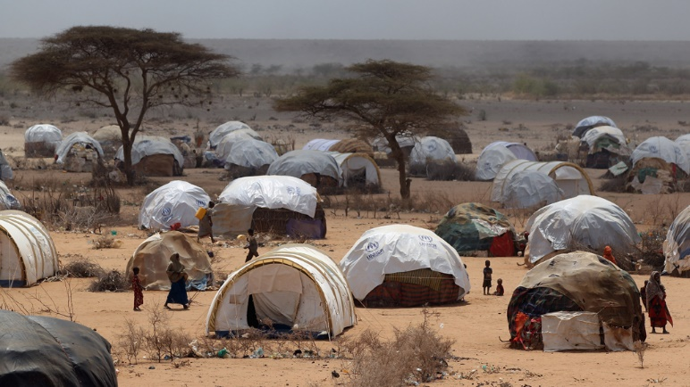
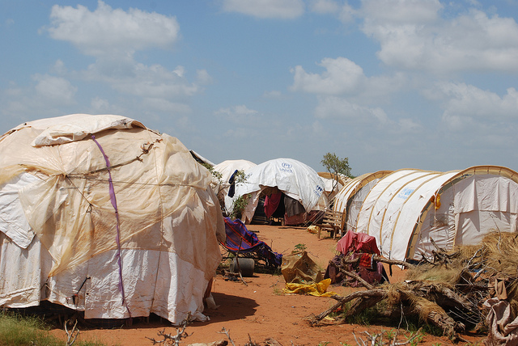
Motivation (why we did this?)
Counting objects (detect refugees tents) to estimate the no. of population/ refugee camp extension (development).
Useful information for international organizations (NGOs)
Ifo 2: Dadaab refugee camp, Kenya

Slide 7
State of the art
Image segmentation/ buildings detection/ machine learning methods
Convolutional Neural Network (CNN)
AdaBoost algorithm
Linear Discriminant Analysis (LDA)
Support Vector Machine (SVM)
Edge Detection (Canny edge detection)
Corners: Harris corners detection
REFERENCES:
Castelluccio, M., et al. (2015). "Land Use Classification in Remote Sensing Images by Convolutional Neural Networks." arXiv preprint arXiv:1508.00092.
Cote, M. and P. Saeedi (2013). "Automatic rooftop extraction in nadir aerial imagery of suburban regions using corners and variational level set evolution." Geoscience and Remote Sensing, IEEE Transactions on 51(1): 313-328.
Guo, Z., et al. (2016). "Identification of Village Building via Google Earth Images and Supervised Machine Learning Methods." Remote Sensing 8(4): 271.
Li, E., et al. (2015). "Robust rooftop extraction from visible band images using higher order CRF." Geoscience and Remote Sensing, IEEE Transactions on 53(8): 4483-4495.
Manno-Kovacs, A. and T. Sziranyi (2015). "Orientation-selective building detection in aerial images." ISPRS Journal of Photogrammetry and Remote Sensing 108: 94-112.

Slide 8
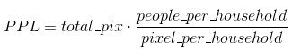
Methodology
Tents can be very well distinguished from the environment
Combine thresholds
Remove clouds
Artifacts->opening
Labeling objects
Extracting features
Calculate the number of people based on next formula

Slide 9
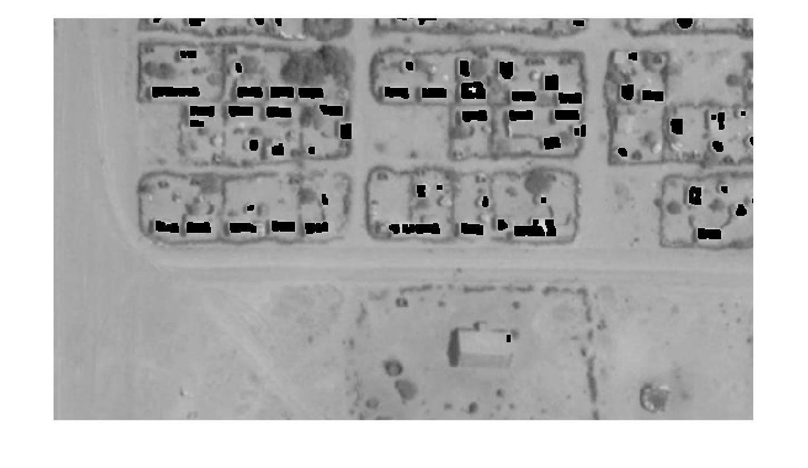
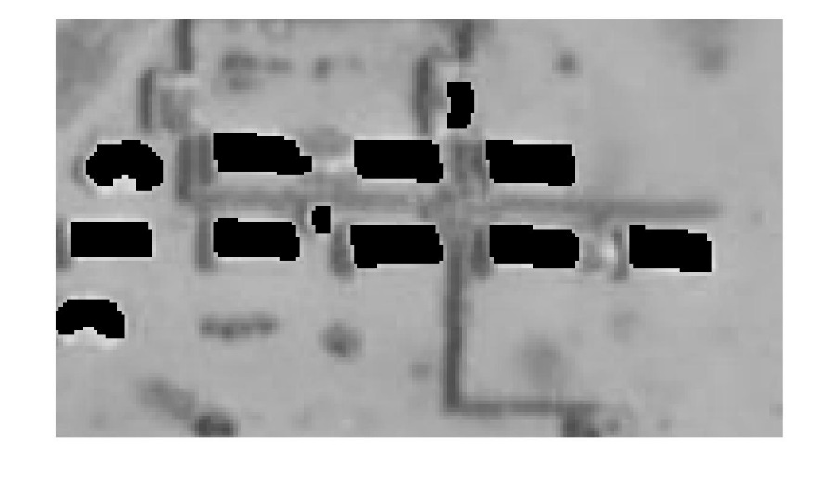
Results -- Population estimation in Ifo 2 Dadaab refugee camp
the results of our algorithm
+
other information (e.g. average household sizes of Somalis)
Estimate the population of the total camp
Source | Date | Population estimation
Official Estimation according to UNHCR | 31.05.2016 | 46.334
Official Estimation according to UNHCR | 30.06.2014 | 51.685
Our Estimation | 30.06.2014 | 53.958

Slide 10
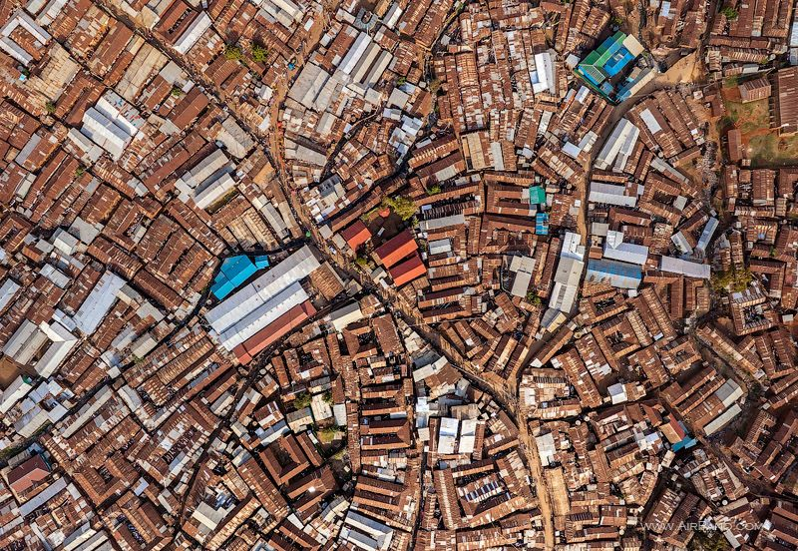
Kibera informal settlement - Kenya
- Image complexity = heterogeneity
Hard to count the building roofs:
Different types of roofs materials = different texture
Different roof geometry, size
Densely build-up urban areas
Noises like man-made objects
2. Poor spectral features for RGB images

Slide 11
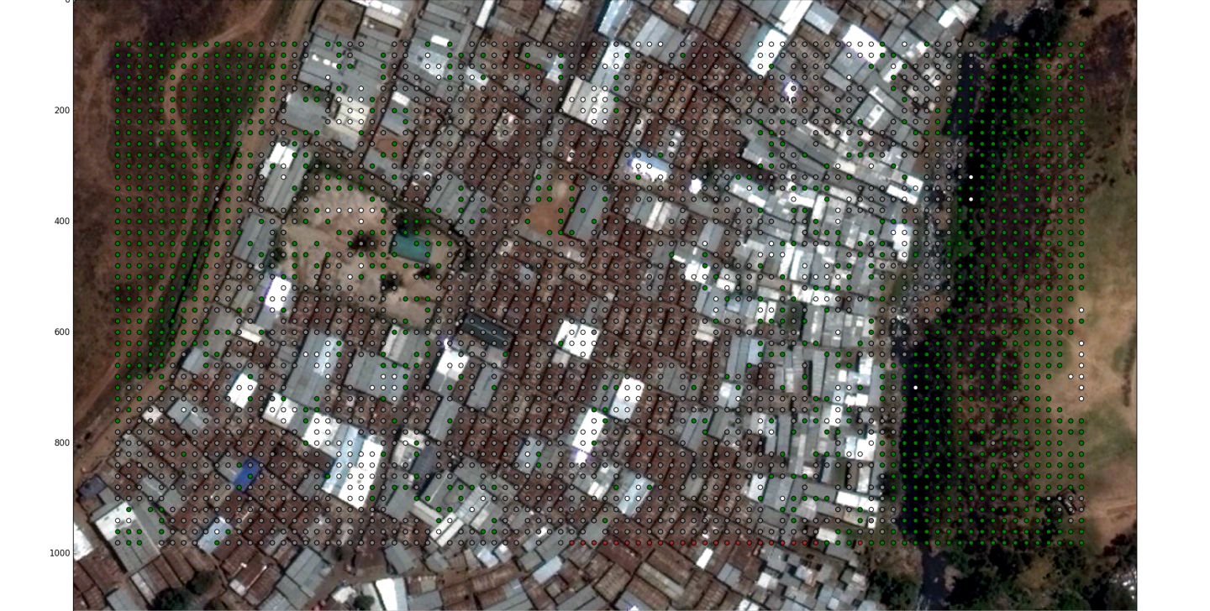
Kibera - ML Segmentation

Slide 12
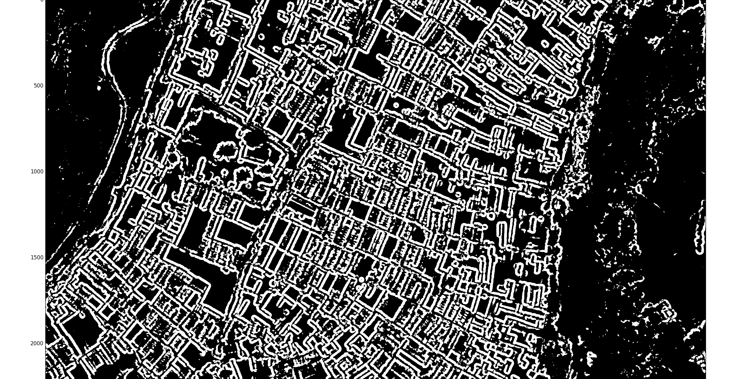
Kibera - Streets

Slide 13
Conclusion
Pair programming and tutorial
First tastes of…
Python/MATLAB
Image Processing/ML
Web-Dev
Refugee Camps
Results close to official UN numbers
Kibera
Displayed open challenges
Limits of pure image processing

Slide 14
Dziękujemy za uwagę!
Анхаарал тавьсан та бүхэнд баярлалаа!
Multumesc pentru atentie!
Köszönöm a figyelmet!

